Slide 1
Representation Power of MLP
the Essence of Neural Computation

Slide 2
Terminology
1. Single-Layer Perceptron (SLP): Basic architecture with a single layer of input neurons connected directly to output neurons.
2. Multi-Layer Perceptron (MLP): Contains one or more hidden layers between input and output layers, enabling complex pattern recognition.
3. Feedforward Perceptron: Information flows in one direction, from the input to the output layer, without cycles or feedback loops.
4. Recurrent Perceptron: Utilises feedback connections, allowing information to loop back within the network, and enabling temporal dynamics and memory.

Slide 3
Terminology
5. Convolutional Perceptron: Designed specifically to process grid-like data, like images, by employing spatial hierarchies and convolutional layers for feature extraction.
6. Radial Basis Function (RBF) Perceptron: Employs radial basis functions as activation functions, often used for function approximation tasks.
7. Probabilistic Perceptron: Incorporates probabilistic models or activations, useful for uncertainty estimation and probabilistic reasoning.

Slide 4
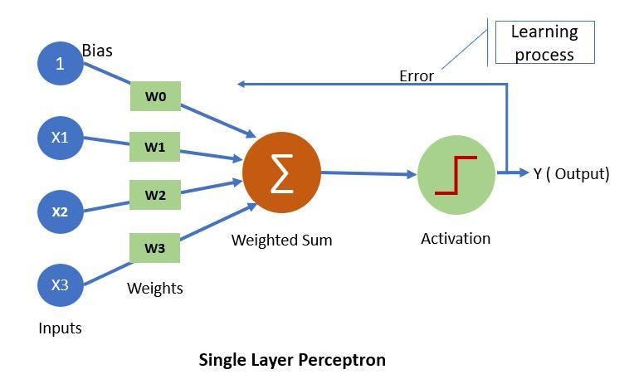
SLP

Slide 5
SLP→ANN
A single-layer perceptron (SLP) is the simplest form of artificial neural network (ANN), comprising only one layer of output neurons. Key points:
1. Architecture: SLP has one layer of output neurons directly connected to input features. 2. Activation Function: Typically, it uses a step function, outputting 1 if the weighted sum of inputs exceeds a threshold, 0 otherwise.
3. Training: Trained using the perceptron learning algorithm, adjusting weights based on errors between predicted and actual outputs.
4. Linear Separability: It can only handle linearly separable patterns, limiting its classification capabilities to data separated by a straight line or hyperplane.
5. Applications: Used in binary classification, pattern recognition, and linear regression tasks. However, its simplicity and limited capability have led to more sophisticated neural network architectures like multi-layer perceptrons (MLPs) and deep learning models.

Slide 6
Breakthrough
In the 1980s, researchers such as Rumelhart, Hinton, and Williams proposed the backpropagation algorithm, enabling efficient training of the Multi-Layer Perceptron (MLP).
This paved the way for the development of deeper neural networks, unlocking their potential for solving complex tasks.

Slide 7
Multi-Layer Perceptron (MLP)
The Multi-Layer Perceptron (MLP) is a class of feedforward artificial neural networks characterised by multiple layers of interconnected nodes, or neurons.
Unlike its predecessors, such as the perceptron, MLP consists of an input layer, one or more hidden layers, and an output layer.
Each layer comprises multiple neurons, and connections between layers are weighted, allowing the model to learn complex patterns from input data.

Slide 8
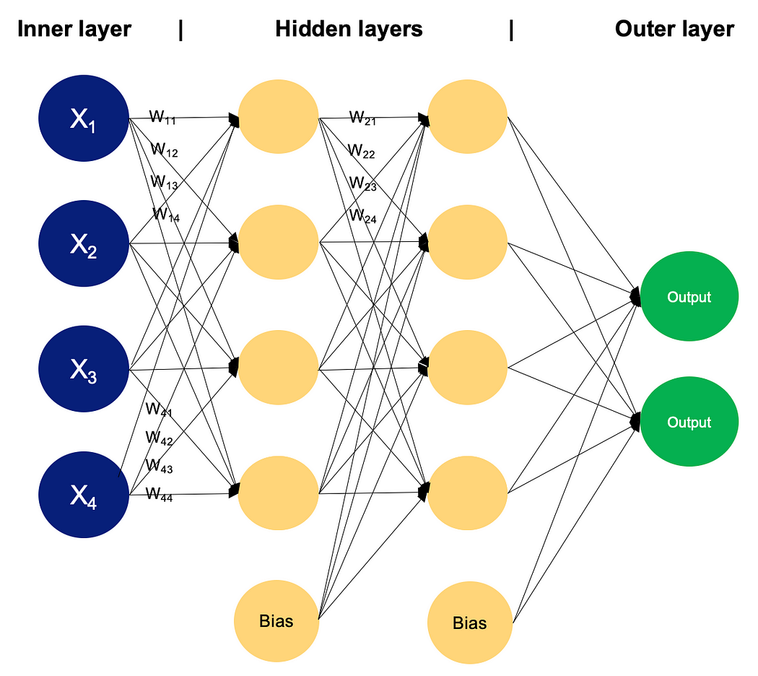
An MLP

Slide 9
Multi-Layer Perceptron (MLP) overcomes the limitations of Single Layer Perceptron (SLP)
1. Complex Patterns: MLP can learn complex patterns and relationships in data due to its multiple hidden layers, allowing it to capture nonlinearities that SLPs cannot handle.
2. Non-linear Activation Functions: MLPs can use a variety of non-linear activation functions in hidden layers, enabling them to model complex mappings between inputs and outputs.
3. Universal Approximator: MLP with a single hidden layer containing many neurons can approximate any continuous function, making it more versatile than SLPs for a wide range of tasks.
4. Feature Representation: MLPs can automatically learn hierarchical representations of features through multiple layers, facilitating better feature extraction and representation learning.
5. Improved Performance: In practice, MLPs often achieve higher accuracy and better performance on various tasks compared to SLPs, especially for datasets with non-linear relationships between input features and target variables.

